Slide 1


HR Recruitment Process
[YAHYA CHERKANI & AMINE NAJI]

Slide 2
What is HR recruitement process ?
Definition :
The HR recruitement process is how Human Resources finds and hires the right people for the company.
2

Slide 3

Job Analysis and Planning
Define job analysis and its key role in recruitment
Importance of thorough workforce planning before hiring begins
Identify essential skills and qualifications for the role
Align job requirements with organizational goals and needs

Slide 4

Sourcing Candidates Effectively
Utilize job postings to attract a wide audience
Leverage employee referrals for trusted recommendations
Collaborate with recruitment agencies for specialized talent
Explore social media platforms for targeted outreach

Slide 5

Screening and Selection Process
Review resumes and applications for qualifications and skills
Conduct interviews to assess candidate fit and potential
Utilize assessment tools to evaluate strengths and weaknesses
Make decisions based on defined selection criteria and needs

Slide 6

Hiring and Onboarding Essentials
Extend a formal job offer to selected candidates
Discuss salary, benefits, and other terms thoroughly
Prepare onboarding materials and resources beforehand
Assign a mentor to support the new hire's transition

Slide 7

External Recruitment Advantages
Access to a larger talent pool for diverse skills
Brings in fresh ideas to rejuvenate the organization
Increases organizational diversity and innovation potential
Fosters new perspectives that can enhance creativity
Ability to fill specialized roles that require unique expertise

Slide 8

Challenges of External Recruitment
Higher costs associated with external hiring processes
Longer time to fill positions compared to internal recruitment
Risk of cultural misfit affecting team dynamics
Potential for longer adjustment periods for new hires

Slide 9

Internal Recruitment Advantages
Promotes employee morale and job satisfaction within teams
Accelerates onboarding and integration for new positions
Cost-effective solution compared to external hiring options
Retains organizational knowledge and experience in the workforce
Encourages career development and growth opportunities internally

Slide 10

Internal Recruitment Challenges
Limited talent pool can hinder innovation and growth
Potential for internal conflict among team members
Jealousy may arise from promotions or transfers
Risk of stagnation if not managed effectively

Slide 11

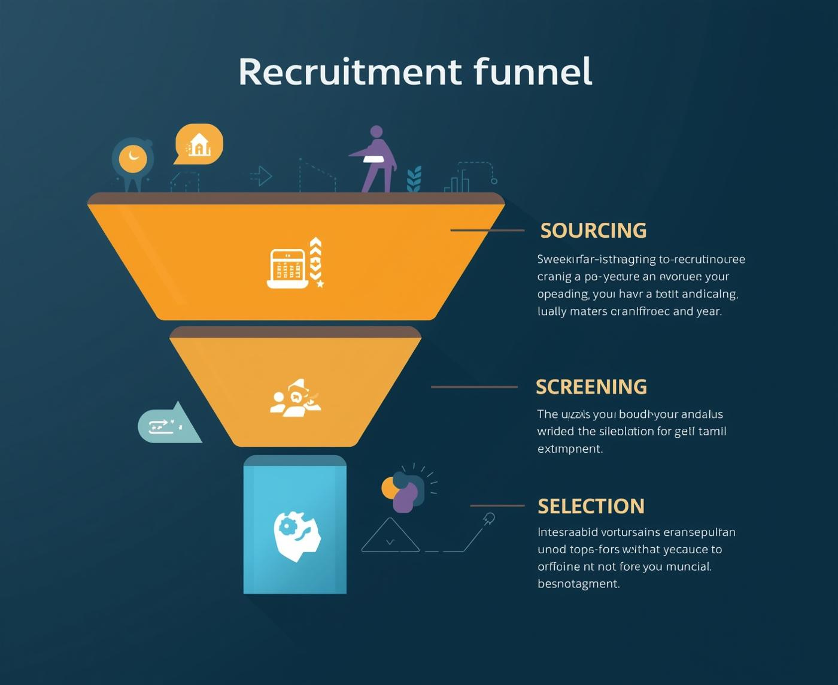

External vs Internal Recruitment
Understanding Key Differences and Benefits
Comparing external and internal recruitment reveals crucial insights for organizations. Each approach has unique advantages and challenges that influence hiring strategies and overall workforce dynamics.
12

Slide 12



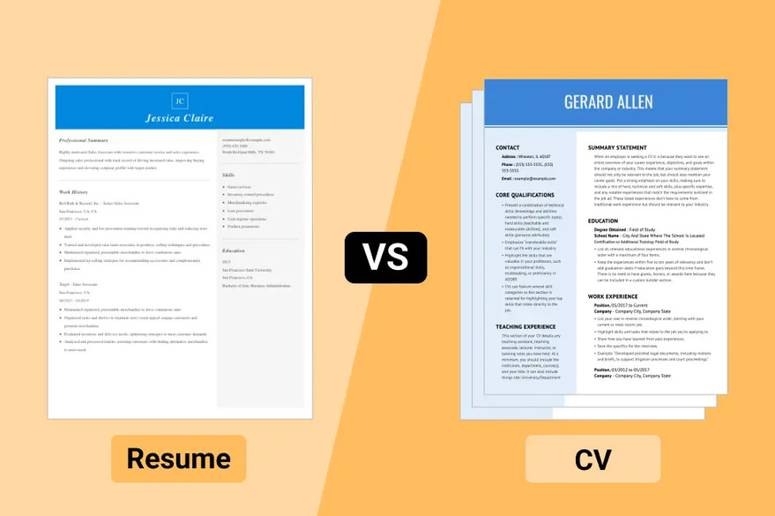

Vocabulary page : 22
Staffing
Payroll
Vacancy
CV vs Resume

Slide 13




Vocabulary page : 22
E-recruitement
Referrals
Job fairs
Probationary

Slide 14
Thank You for Your Attention!

